Slide 1
Competitive Athletic Programs in COVID
Finding the Right Approach for Your School
Notes:
MATT

Slide 2


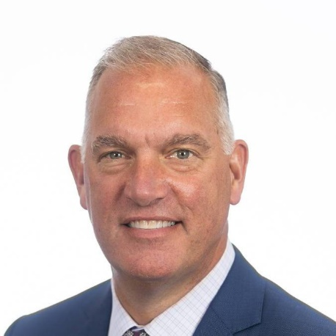

Speakers
Greg Schneider
Ronald M. Druker ’62 Head of School
Belmont Hill School
Matt Morrissey
Chief Operating Officer
Fusion Cell
Joe Williams
Head of School
New Hampton School
Mike Klingshirn, MPH, CPH, PMP
Director of Consulting Services
Fusion Cell

Slide 3
Agenda
About Fusion Cell
Athletics and COVID
Case Studies - The Athletic Planning Process: K-8, Day, and Boarding Schools
  K-8
  Belmont Hill Discussion
  New Hampton School Discussion
How to Develop Your COVID Athletics Plan
Current Topics and Looking Ahead
Q&A
Notes:
MATT
K-9 Health and Wellness

Slide 4





Fusion Cell Brings High-Quality Talent from the US Military to Corporations
Permanent Placement
Temporary Staffing
Specialty Services
Skill Areas
Emergency Management
Veteran Relations
Cybersecurity/Intelligence/IT Analysts
Engineers
Technicians
Operations & Logistics Analysts
Professional Services Talent
Healthcare Talent
Public Safety Talent
Business Leaders
Virus/Pandemic Risk Mitigation (e.g., COVID-19)
Organizational Veteran Readiness
Internship Programs with the DoD
Cybersecurity
Physical Security
Notes:
MATT – brief FC evolution to C-19 - STAFFING AND CONSULTING (Specialty Services)
Cybersecurity/Intelligence/IT Analysts
Engineers (e.g., Software, Electronics, Civil)
Technicians (e.g., Electronic, Communications)
Operations & Logistics Analysts (e.g., Transportation, Supply Chain, Contracting)
Professional Services Talent (e.g., Finance, Legal, HR)
Healthcare Talent (e.g., Nurses, Dentists, Mental Health Counselors, Public Health Experts)
Public Safety Talent (e.g., Fire Fighter, EMT, Security, Police)
Business Leaders (e.g., General Management, Sales, Customer Service)
Specialty services
On this side we don’t just provide people, but we have solutions and recommendations we can provide
Physical security – we can do an assessment of your entire physical security and run an exercise to find vulnerabilities. Evaluate protocol, people, procedures, including how to partner with local police. We can help you create a safer campus – whether school or business.

Slide 5
The Fusion Cell Advantage for COVID-19 Health and Safety Planning
Expertise
Board-certified Public Health Experts
Epidemiology
Industrial Hygiene
Human Resources
Experience
Infectious Disease Control
Pandemic Operations
US Military, FEMA, HHS, FDA, OSHA
Solutions
COVID-19 Readiness Assessment
Create, Implement, and Maintain Plans
On-call Advice
Notes:
MATT

Slide 6























Schools and Businesses Using Our Virus Risk Mitigation Services
Notes:
Matt (end @7 mins)
What we have done to date – with who – been a busy summer –
We anticipate more businesses than schools as

Slide 7

Michael Klingshirn
Director of Consulting Services
Background:
  Pharmacology (BS) Epidemiology (MPH) Biostatistics (GC)
    Board-certified in Public Health (NBPHE)
    Air Force education in Leadership, Contingency Planning, Public Health Emergencies, Entomology, Hospital Infection Control
  Veteran of the US Air Force, with 10 years Active Duty
COVID-Specific Experience
  Oversaw 15 schools and business COVID health and safety plans since May
  Directed the equivalent of a local health dept. in 2 states and 3 countries
  Stood up Task Force COVID in March 2020
  COVID manager for all Air Force Bases in the Middle East
  Created the Air Force standard for Disease Containment Planning in 2010
Notes:
MATT – TO MIKE BRIEF BACKGROUND

Slide 8
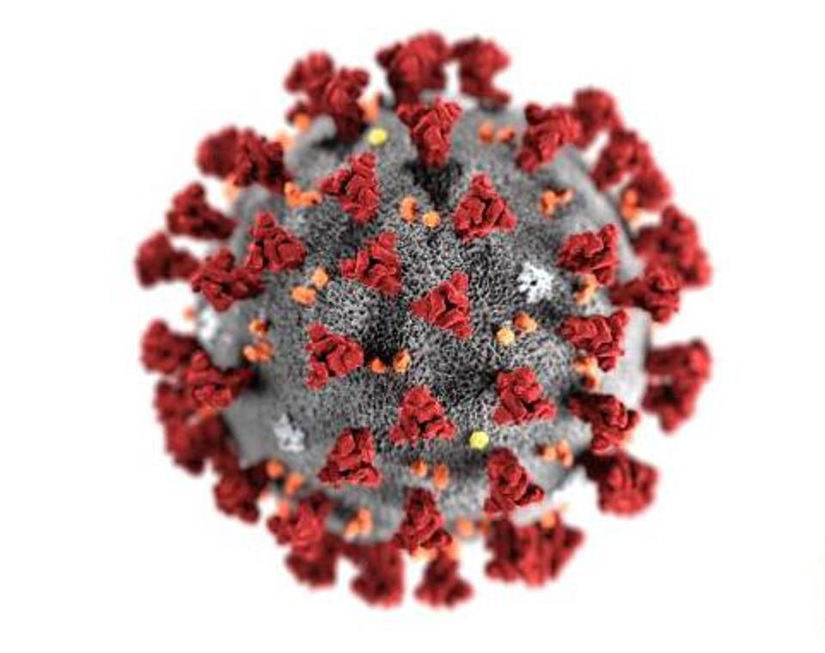
Why It’s So Hard to Solve – The Challenges
Notes:
Mike (at 15 min mark)

Slide 9

The Challenges of Winter Sports
Pre-symptomatic people
Asymptomatic people
Spreads easily
Complacency
CDC Indoor Risk Change (10.5.2020)
Cold and flu season
Moving indoors with cooler weather
Game day officials

Slide 10






















Navigating the Recommendations
Notes:
https://www.nhmunicipal.org/sites/default/files/uploads/webinars/safer2.png
The Point of this slide – you get bombarded by many agencies from the international level to federal to state to local (town and conference)

Slide 11






State Snapshots
State | Requirements
MA | Mask restrictions at certain times, highly regulated play (hockey shut down), testing before entering and quarantine before returning
NH | Mask restrictions at certain times, some modified play, restrictions on out-of-state schools, travel quarantine (non-NE states) (hockey shut down)
ME | Mask restrictions at certain times, some modified play, restrictions on out-of-state schools, travel quarantine requirements (Hockey in violation of rules)
RI | Mask restriction at certain times; modified play – prioritize outdoors, travel quarantine by state
VT | Mask restrictions at most times, restrictions based on county, restrictions on sports that may be played, restrictions on competitions (no winter guidance)
*
*
*
*
Restrictions by state or county
Universal masking when
not playing
Sport modifications or limitations
Team quarantine from out of state travel
Notes:
MA – Hockey is shut down. Levels of play – 4 levels (skills, teams, games, tournaments) each sport is low, moderate or high. Basketball, ice hockey, cheer is HIGH. Dance is moderate *MIAA/DESE/EEA
NH – no risk or levels of play defined. Travel quarantine – quarantine for non-NE players and teams.
ME – Hockey is under the spotlight – not allowed indoors per guidance. 400 kids exposed from 1 ref. 6 levels of play, skills, teams (distanced) intramural, competition (regional), competition (state) competition (other states) Basketball and ice hockey are moderate risk. Competitions are outdoors only.
RI – Low moderate high – basketball hockey moderate.
Vt – Phase 1-3, team (distanced), scrimmage, games. No games currently allowed for VT. No guidance for Winter sports. Highly restrictive – only competitions in VT may take place, and only for lower risk sports. Basketball and football not allowed. No tournaments .
Point of this slide – the lack of uniform “here is the formula” has led to the evolution of very different landscapes across New England that each school has to adjust to, but also SOME SCHOOLS ARE USED TO PLAYING OTHER SCHOOLS IN OTHER STATES

Slide 12






School Specific Considerations
School Athletic Culture
Geographic Location
Boarding, Day, Hybrid
Facilities
Club Sport Policy
Recess Policy
Notes:
School athletic culture includes parents and varies by sport
-are you the Brewster of basketball?
Do students expect to have club sports?
School athletic culture
Parents/student expectations
Expectations by sport
Do you need to play with others

Slide 13
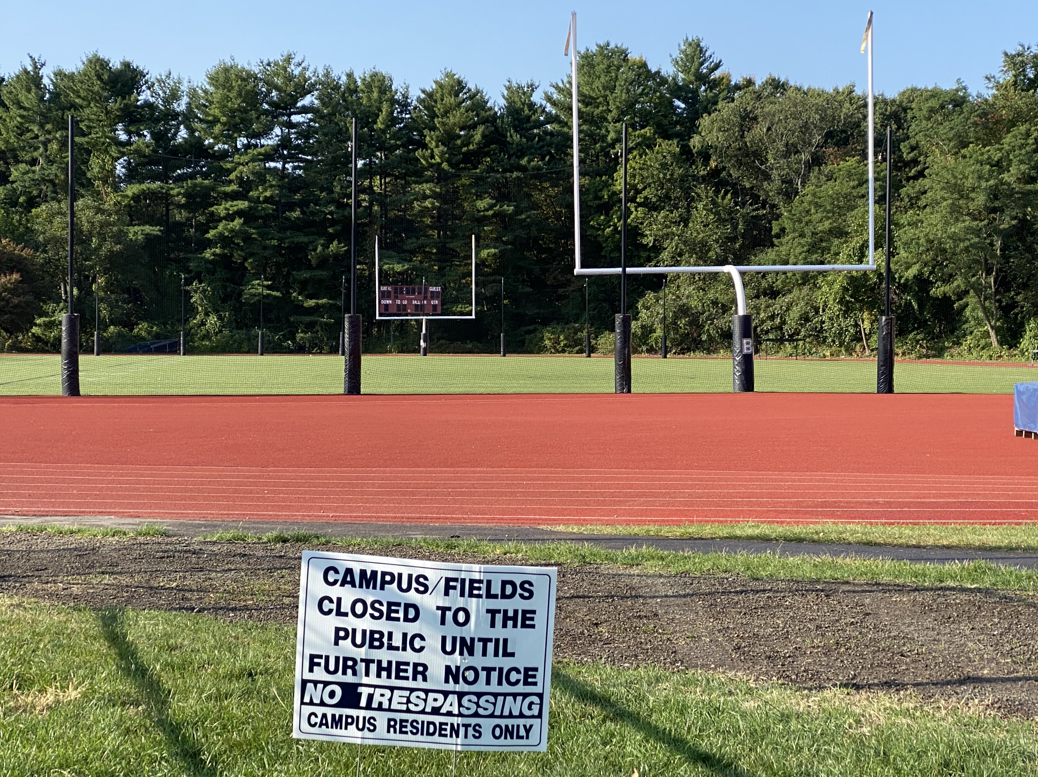
The Athletic Planning Process:
K-8, Day, and Boarding Schools
Notes:
STAY on this slide until you get the “NEXT” from Mike!
Key considerations: How good are academic interventions for defeating COVID spread?

Slide 14
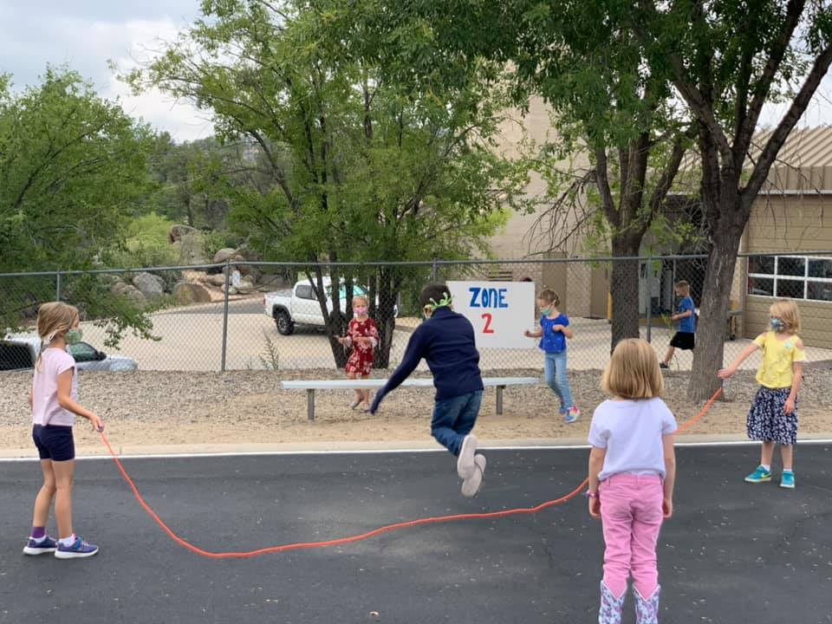
K-8
K-8
https://azednews.com/

Slide 15

Belmont Hill
Belmont Hill educates boys in mind, body and spirit to develop men of good character
Description
School motto: Working together
Grades 7-12
17 buildings on 37 acres
A school for boys: 464 students, including 22 boarders, representing more than 70 towns
Sports and Facilities
NEPSAC and Independent School League affiliated
16 interscholastic sports, 57 teams
The Jordan Athletic Center: Olympic-size hockey arena, double gymnasium, 7 intl. squash courts, wrestling room, event room
Almost all teachers coach multiple sports - teacher/coach model

Slide 16
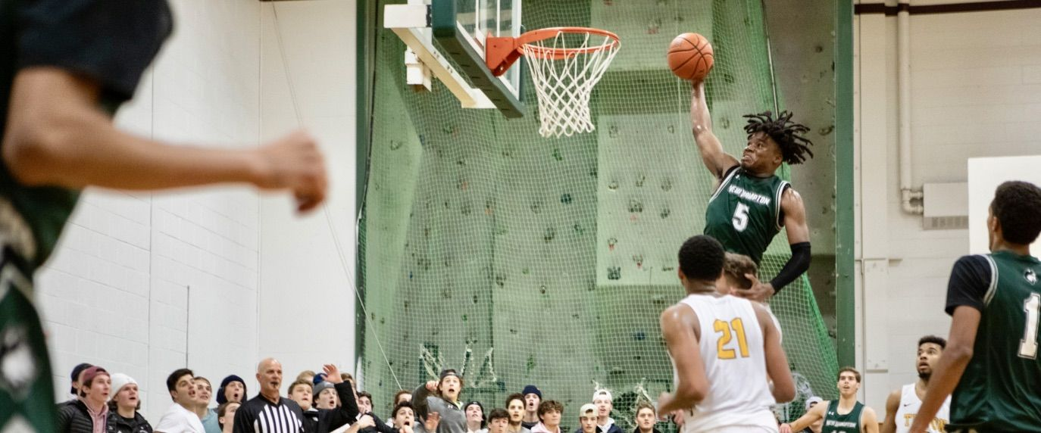
New Hampton School
New Hampton School cultivates lifelong learners who will serve as active global citizens
Description
Grades 9-12, PG
Boarding school
340 students
17 interscholastic sports, 39 teams, including
  Basketball
  Hockey
  Football
  Soccer
  Lacrosse

Slide 17
The “Big Six” for COVID Intervention
HVAC
Disinfection
Exclusion
Masks
Hand hygiene
GREAT PLAN!
Distance
Increase fresh air intake and filter capability: (ASHRAE)
Sanitation/disinfection: (EPA List N)
Health screenings: (hard copy vs electronic [Protect Well])
Distance: (CDC/State/Local guidance)
Masks and mask mandates: (State/local guidance)
Hand hygiene: (CDC/State/Local guidance)
Notes:
Mike

Slide 18
Fusion Cell’s Control Lenses
Engineering Controls
Administrative Controls
Health Screenings
HVAC (when indoors)
Physical Distancing
Common Areas/Equipment
Crowd Control (are crowds allowed?)
Schedules
Exclusion Controls
Sick Athlete Protocol
Travel Policy/Quarantine/Testing
Sanitation/Disinfection
Transportation Plans
PPE
Occupancy Limits
Hand Sanitizer Availability
Masks
Exposure Quarantine
Isolation
Porta-potties
Sick Official Protocol
Sick Coach Protocol
Notes:
MIKE

Slide 19


Additional Considerations for Each Sport
Risks
Safety Measures
Closeness of participants
Indoors/outdoors
Time of close contact
Shared equipment
Contact type: intentional vs. accidental
Age of players
Players at higher risk
Size of team
Game modifications
Layout/facility modifications
Focus on skills, not competition for practices or close contact sports (wrestling and basketball)
Team cohorts – defense and offense cohorts
Hand hygiene and respiratory etiquette
Step-by-step progression to higher risk stages
Eliminate shared equipment

Slide 20
Key Elements
Developing Your Plan
Screening/testing exclusions students/coaches
Sport modifications
Screening/testing of Officials
Best Chance for Success!
Facility HVAC supports safe play
Assumptions:
Governor does not shut down your sport
Universal masking (exception: active athletes)
Schools can support additional screening and testing of athletes
Excellent communication
No crazy spikes in any area

Slide 21
Evaluate Risk Tolerance by Category:
Example: Protocols for Officials
Assessment:
Risk Tolerance Report
Decision Category | Lower | Moderate | High
OFFICALS/REFEREES | Each school provides an Official | - Allow only officials from the region to participate | - Allow officials from outside the region - Large regions may be require intra-region official is available or healthy.
SCREENING (includes temperature) | - Official screens each day, starting 3 days prior to competition - Official screens prior to entry | - Official screens prior to travel - Official screens prior to entry of the facility | - N/A
TESTING (consider testing requirements in line with defined protocols) | - PCR/pool test completed in line with Tuesday/Thursday protocol | - PCR/pool test completed each Wednesday of the season regardless of duties to officiate | - PCR/pool test completed each Wednesday
Notes:
MIKE

Slide 22
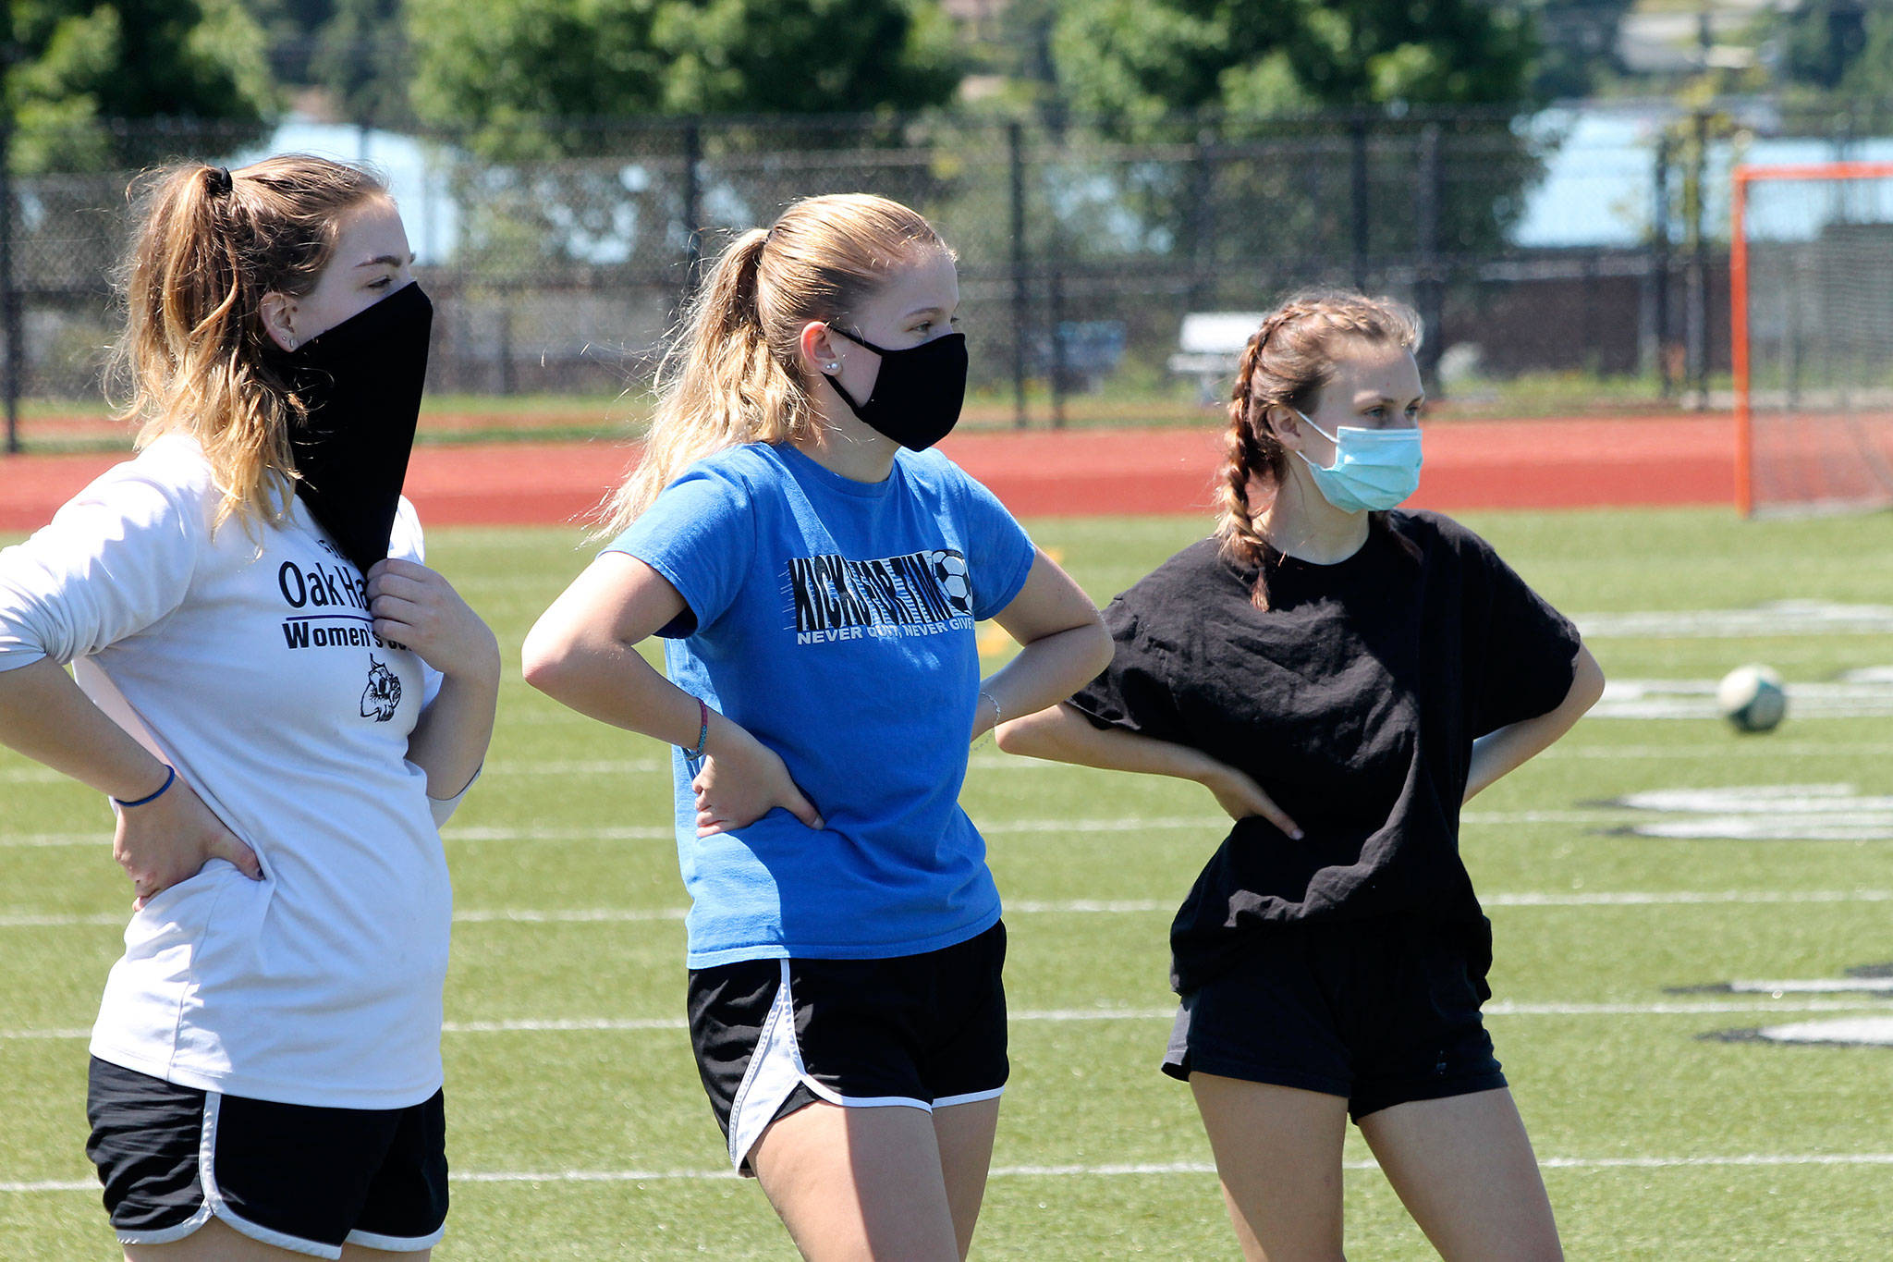
Current Topics and Looking Ahead
https://www.whidbeynewstimes.com/

Slide 23
Thank You!
Matt Morrissey
Chief Operating Officer
mmorrissey@fusioncell.com
Mike Klingshirn, MPH, CPH, PMP
Director of Consulting
mklingshirn@fusioncell.com
Free Discovery Session: www.fusioncell.com/COVID19

