Slide 1







Road Map for Return
Guidance for returning to school during COVID-19
Dr. Erika Eitland, Research Analyst, Perkins & Will
Brooke Trivas, Principal, K-12 Education, Perkins & Will
Allison Gaines Pell, Head, The Wheeler School
This presentation and its content is copyright of Perkins and Will
© Perkins and Will 2020 (Version 1.0)

Slide 2
Goal 1: Learn the process of developing a holistic framework for a safe & effective repopulation road map

Slide 3
Goal 2: Understand the strategies to confidently communicate & make decisions during this transition

Slide 4

Goal 3: Learn from your peers

Slide 5


Goal 1: Develop a Holistic Framework

Slide 6






How do we do it?
Establish practices, policies, & protocols that promote learning, health & safety
Communicate with your community & respond to their feedback
Procure & Implement plan for returning to school
Return to School
Notes:
Brooke

Slide 7
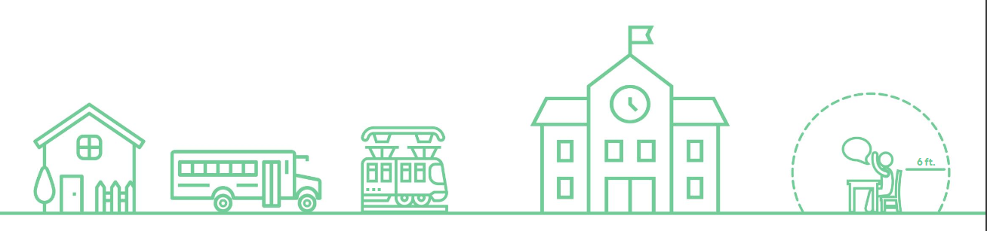
We cannot remove all risks.
Home
Working parents
Social engagements
Multi-generational living
Transit to School
  Public transportation
  School bus density / contamination
Entering School
Contaminated high touch surfaces
Fail to socially distance
Public spaces (bathrooms, lockers, lobby, etc.)
Teaching Spaces
Surface contamination
Recirculating air
Notes:
EE

Slide 8
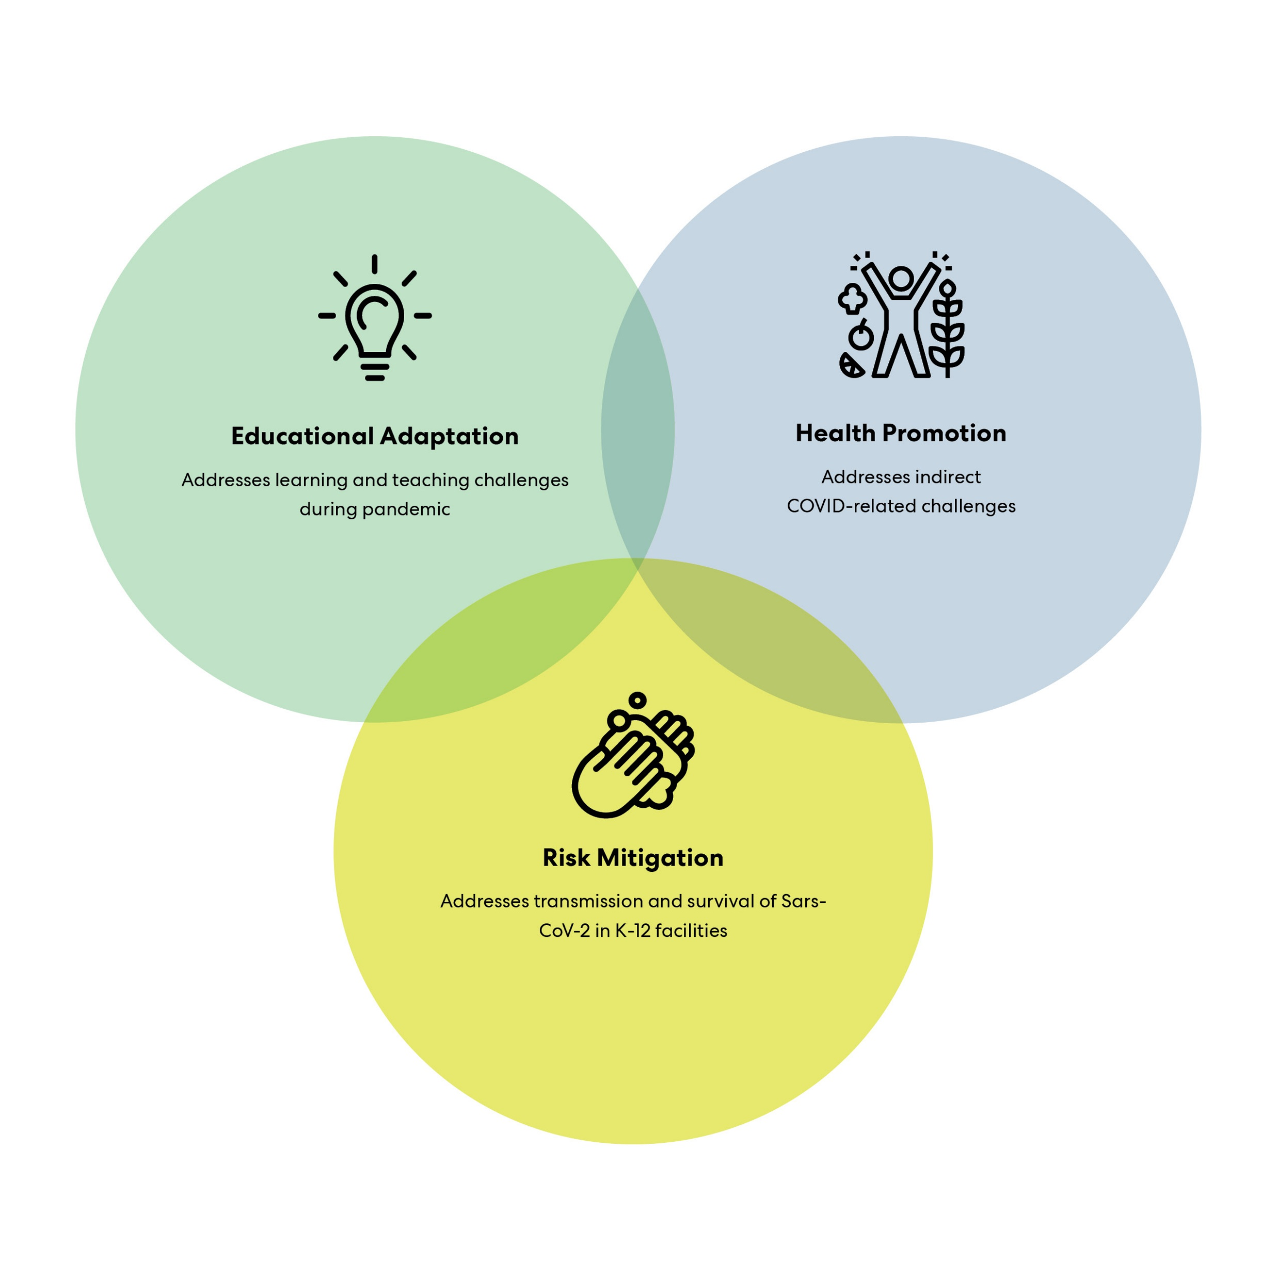
Promote health & safety without compromising students’ learning potential
Notes:
EE

Slide 9


Risk Mitigation
Strategies for reducing COVID-19 transmission and cross-contamination through design, disinfection and cleaning.
Personal protective equipment for different school occupants
Enhanced ventilation and filtration use to dilute and remove contaminated air
Add touchless/voice-activated fixtures to reduce cross contamination
Provide deep, frequent cleaning and engage students in cleaning high touch areas
Student at Yangzheng Primary School in China

Slide 10
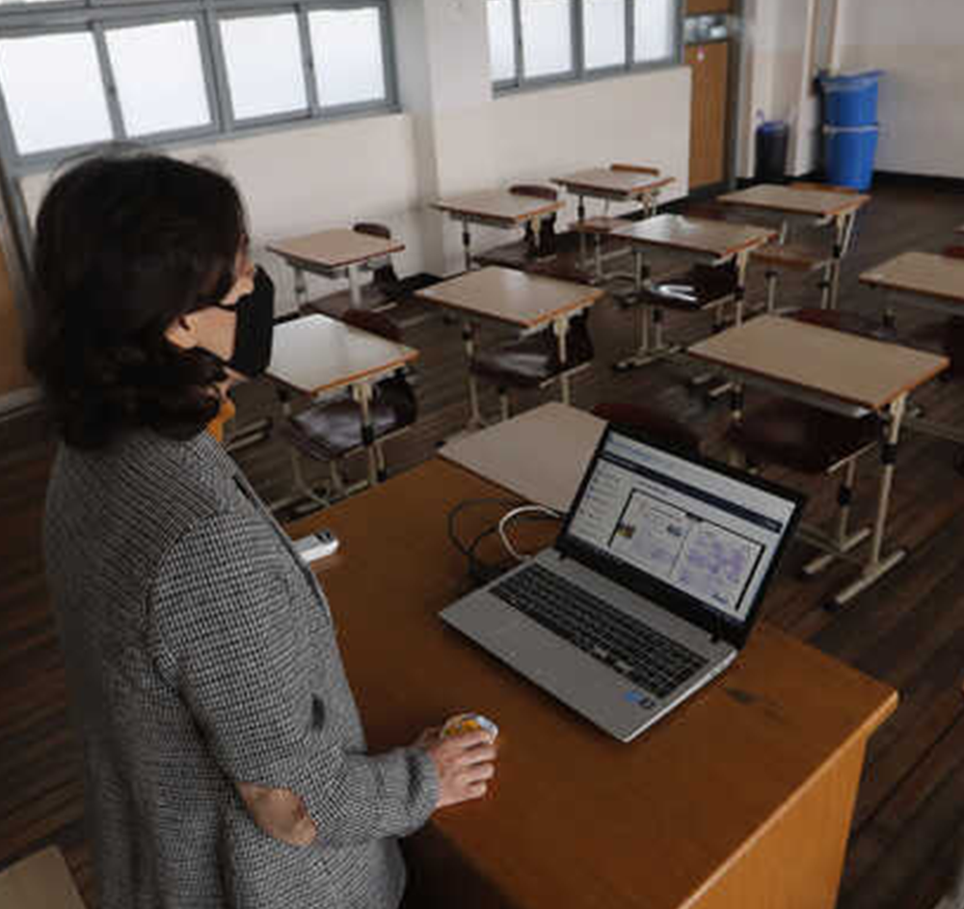

Educational Adaptation
These strategies promote effective learning and teaching in this new normal through behavioral, logistical, and technology changes.
Blended learning using virtual platforms (e.g. lectures, meetings, study groups)
  Add video and microphone capability to classrooms for live synchronous learning
  Create virtual gatherings to foster a sense of school community
Alter education scheduling by staggering start times
Promote outdoor learning and physical education
Integrated curriculum with all classes focused on the history, math, and science of disease transmission
South Korea Reopens Schools

Slide 11
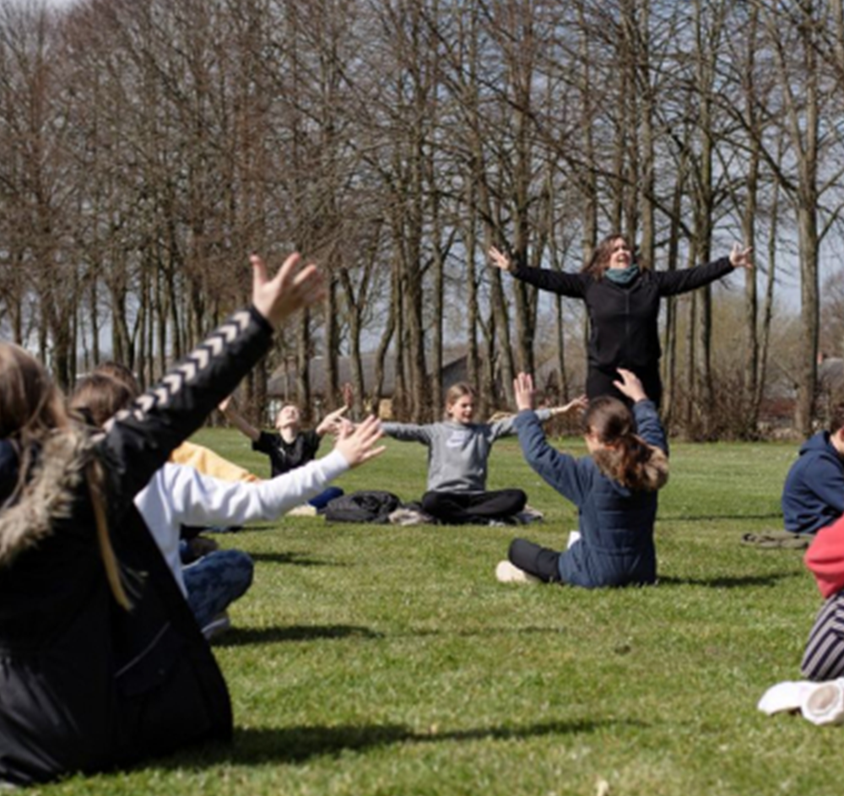
Health Promotion
Strategies that promote physical and mental health, social cohesion, and a sense of belonging and safety.
Design spaces for different levels of interaction and privacy to address differing comfort levels
Treat water to prevent stagnation and microbial growth
Connect students and staff with resources for food, housing, and job security
Teacher holds a music lesson outdoors in Randers, Denmark

Slide 12
Example Timeline
Steps for Repopulating Schools
 | Starting Now | Summer | Fall
Risk Mitigation | Determine capacity of classrooms Identify addition space needs Confirm cleaning/ disinfecting and design protocols | Implement design measures for compliance. | Review Design Implementation measures. Regular deep cleaning of high touch areas | Revise & Evolve Protocols, Plans & Policies
Education Adaptation | Example: Adjust schedule by classroom Create protocol for drop-off/pick-up Adapt large spaces for learning | Establish flexible attendance Mark hallway flow Blended classrooms (virtual/in-person) | Limit technology sharing Limit external volunteers Provide PPE protocols Outdoor recess/PE
Health Promotion | Establish food service protocols Survey students for health concerns Identify COVID officer. Outline Social Emotional care. | Implement SEL practices | Increase services & counselors available
Notes:
BT

Slide 13
“Select strategies based on feasibility given the unique space and needs of the school. Not all strategies will be feasible for all schools. ”
-CDC, “Interim Guidance for Administrators of US K-12 Schools and Child Care Programs”
Notes:
BR

Slide 14





Measures
Factors
Solutions
Education Adaptation
Finances
Available funds
Road Map Back
Resources
Health
Promotion
Staff
Facilities
Land
Timeline
Risk
Mitigation
Occupancy
Procurement
Construction

Slide 15
Goal 2: Understand the Strategies
Capacity Guidelines

Slide 16
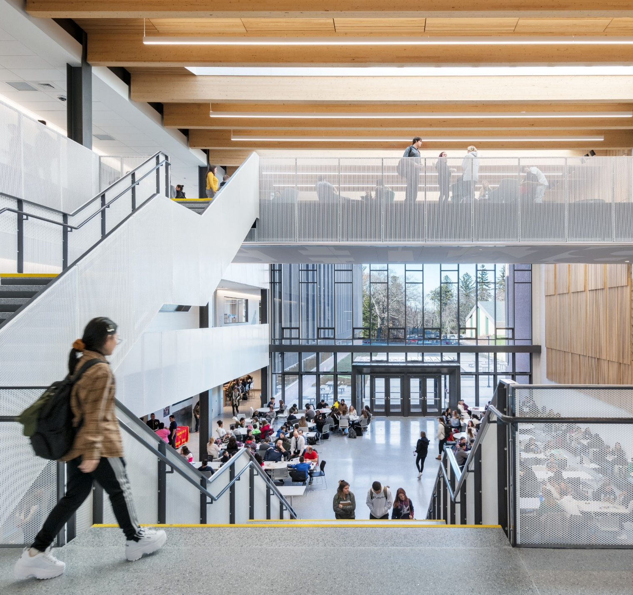
Physical Distancing Capacity Guidelines
Instructional Spaces
  General Classrooms
  Science
  Art
  Etc.
Administrative Spaces
  Offices
  Conference Rooms
Common Spaces
  Cafeteria
  Auditorium
  Gym
  Corridors
  Building Entry
D. Other Spaces
  Bus
Notes:
BR

Slide 17
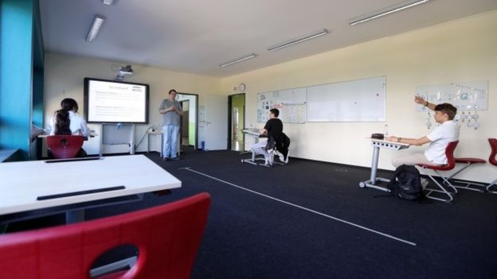
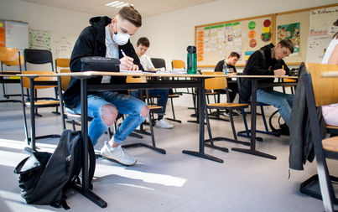
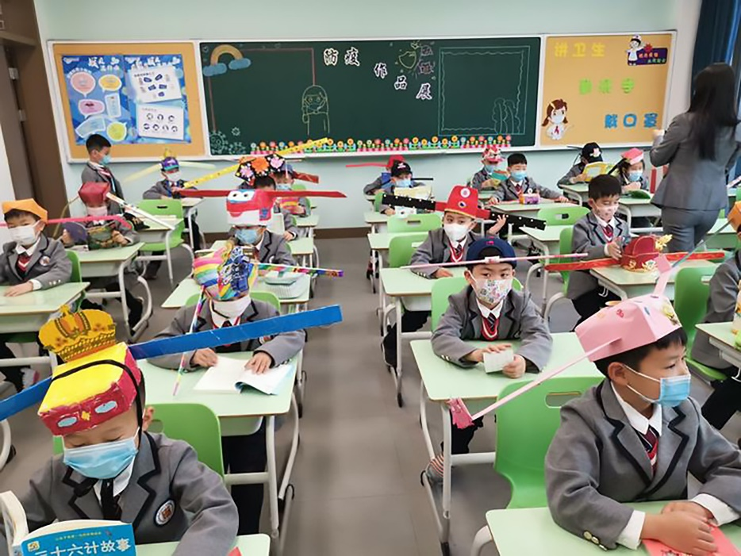
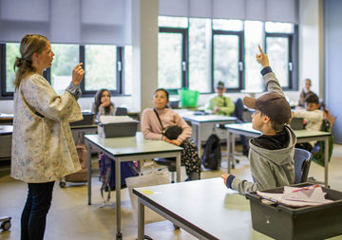
Lessons Learned from Other Countries
Germany
Aisle marks on the floor and desks against the wall
Germany
Alternating occupied and unoccupied desks
China
Students wear hats to promote distance
Copenhagen
Wide aisles and spaced out desks in Copenhagen

Slide 18




Capacity Analysis Process
Classroom Capacity
# of student desks with physical distancing guidelines
Current Schedule
# of students scheduled to be in class during each period
Shortfall
# of students who don’t fit in the classroom after accounting for physical distancing
Strategies
Options for making up the shortfall, either by new delivery models or creating additional instruction space
Notes:
Our focus in this discussion is look at the options for returning to create a more robust action plan for the Transition Phase – however long that is.
Options are organized into (3) categories:
- Work Location - who is working remotely and who is working in the office?
Operations - how will we work when in the office
Behaviors / Messages – what are the key messages during this time and what alternate behaviors are they supporting?
We are in the Response phase now:
100% remote
Alternate protocols in place
Focus on messages related to the crisis and support of remote working
We want to Plan for the Transition (and this is the focus of this discussion):
Phased Increase in Office Population while evaluating the future state
Working in the office with Enhanced Infection Controls
Physical Distancing
Food & Beverage
Limiting Outside
Maintenance
Personal Protection
Messages to convey new ways of working, in-office practices, and supporting employees with guidance & positivity.
When we move out of the Transition phase we can begin to consider our Future Preparations:
How remote working will evolve into our strategy
What measures we need keep and which ones we need to discontinue
And how we will Reinforce lessons from the response and the transition phases to make our workplace even better.

Slide 19
Instructional Spaces

Slide 20
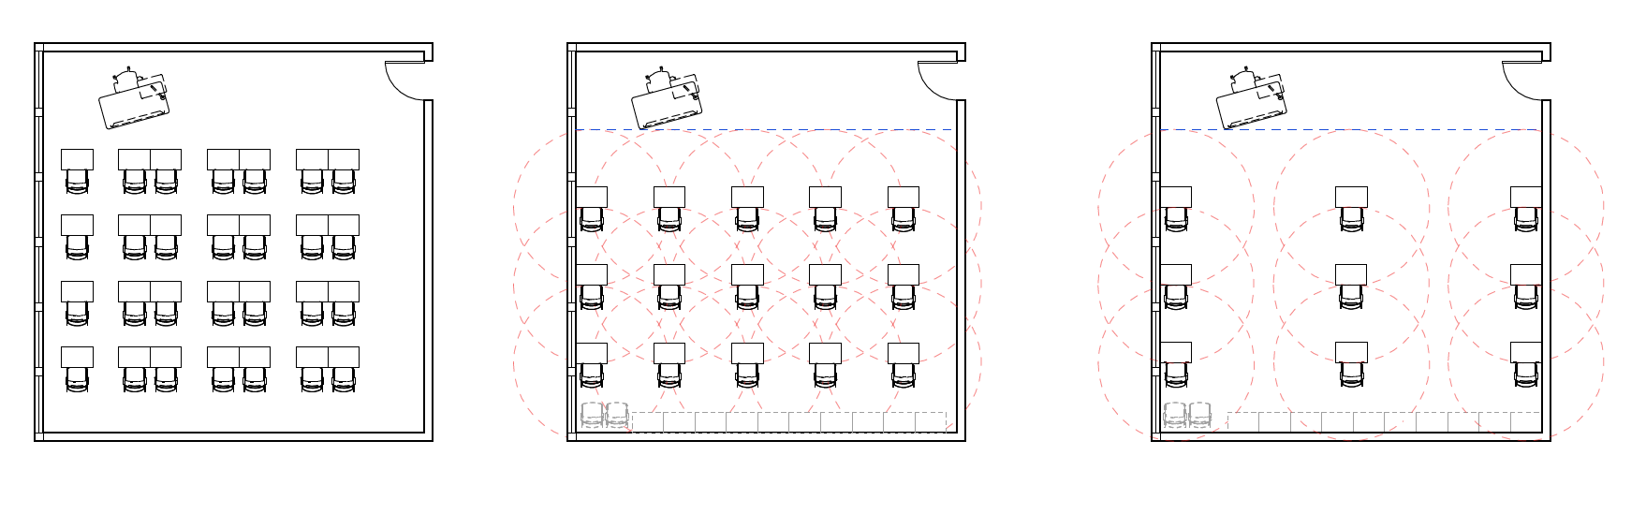
Visualizing New Classroom Capacity Recommendations
Pre-pandemic
900 SF (30’x30’)
No social distancing
28 students
Seated Scenario
900 SF (30’x30’)
6’ distancing when seated
Circulation passes through 6’ radius
15 students (-46%)
Circulation Scenario
900 SF (30’x30’)
6’ distancing at all times
Circulation does not pass within 6’ radius
9 students (-68%)

Slide 21
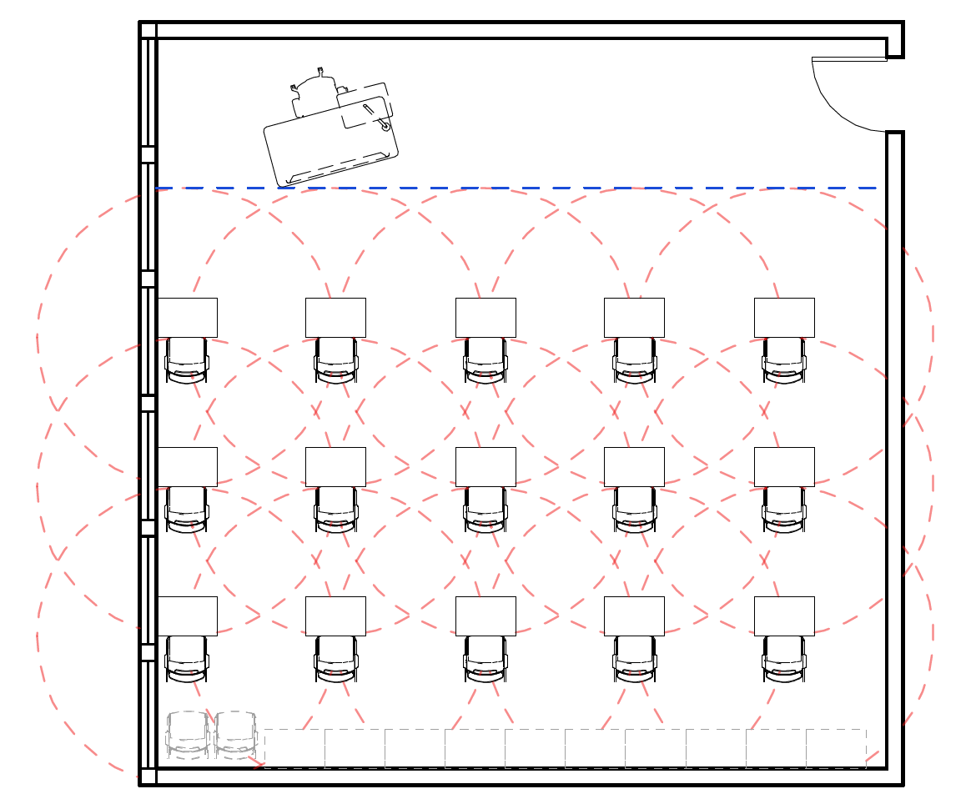
8 Classroom Strategies to Reduce COVID-19 Transmission
6 ft. Radius
1. Designate a sanitation station near the door with hand sanitizer, disinfectant wipes, paper towels, and a waste bin
2. Provide 6’ of clear teaching space at the front
3. Consider a plexiglass shield at the teacher’s desk. Note: some state governments have suggested that the teacher face the same direction i.e. away from the students. We are evaluating whether this is feasible for teaching and classroom management.
4. Consider removing desks directly in front of the teacher station (or protect teacher station with plex barrier)
5. Where possible, place desks against the wall to maximize capacity and reduce risk of physical proximity on one side
6. Create a zone to stack unused chairs and desks that have been removed
7. Use tape, stickers, and signage to indicate traffic flow, physical distances, and unused desks.
8. Remove non-essential objects, manipulatives, and books from rooms to aid in cleaning procedures.
6’ teacher zone

Slide 22
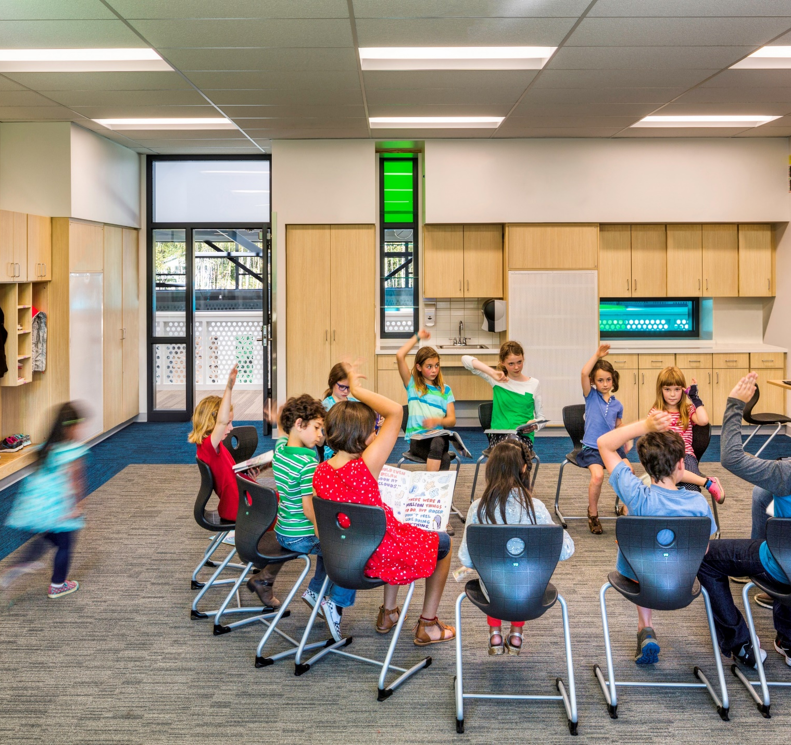



Classroom Usage Guidelines
Have students enter and exit the room in order of their desk’s distance from the door to minimize passing in close physical distance
Disinfect student desks before and after each use. Involve students in the disinfection process.
Disinfect teacher desks between every class period if teachers are rotating between classrooms
Expect students to break the rules of physical distancing in the classroom, either on purpose or by accident
  Use a cohort model: Students stick together and limit exposure to other students
Be Holistic
Notes:
Erika Jumps IN

Slide 23
Administrative Spaces

Slide 24
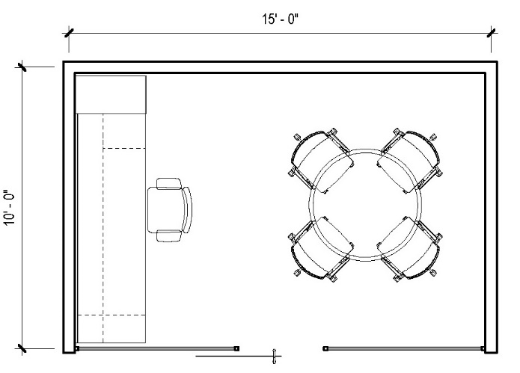
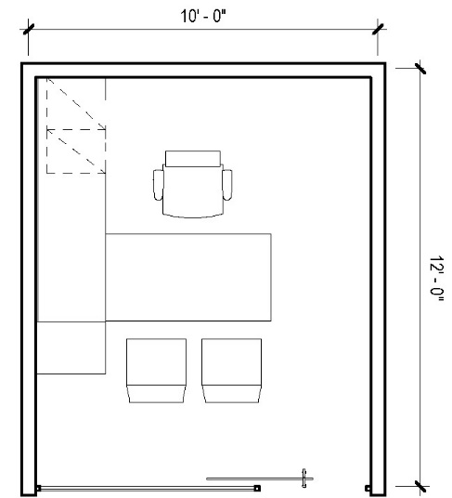
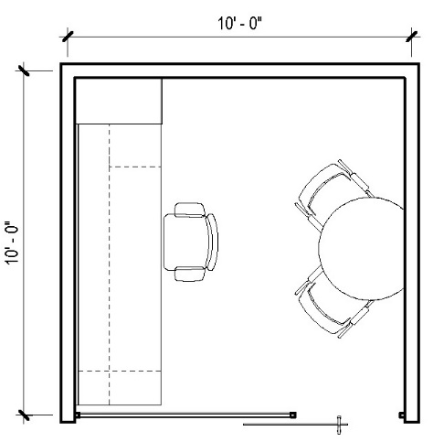
Offices
Occupy
Unavailable
Room Limit
6 ft. guide
6 ft. Radius
Provide 6’ distance around all occupied seats
Depending on the size of the office, guest chairs may be unusable
6 ft. radius circle is placed at a practical stationary work position (chair location will vary on plans)
Diagrams shown are reference examples. Analysis of your specific furniture may differ.
#
1
2
1

Slide 25
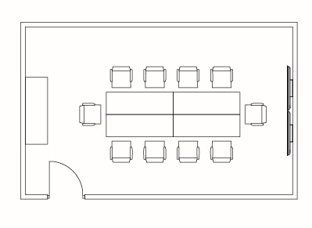

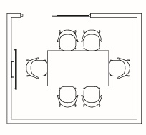
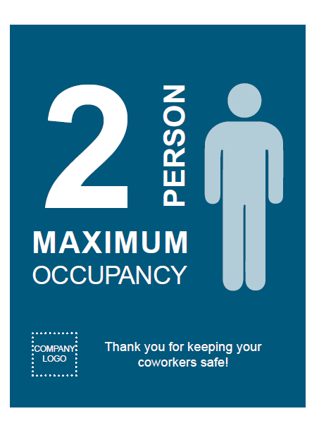
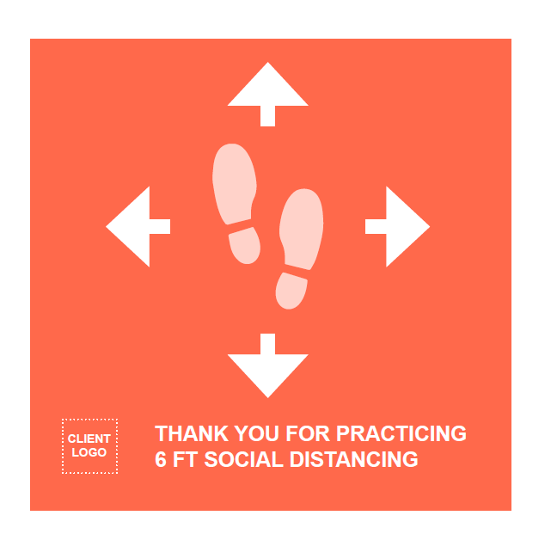
Conference Rooms
Provide 6’ distancing between all conference seats when in use
Mark available and unavailable positions on the table using tape or signage
1
3
Small Meeting Room
Medium Meeting Room
Paired with Custom Graphics

Slide 26
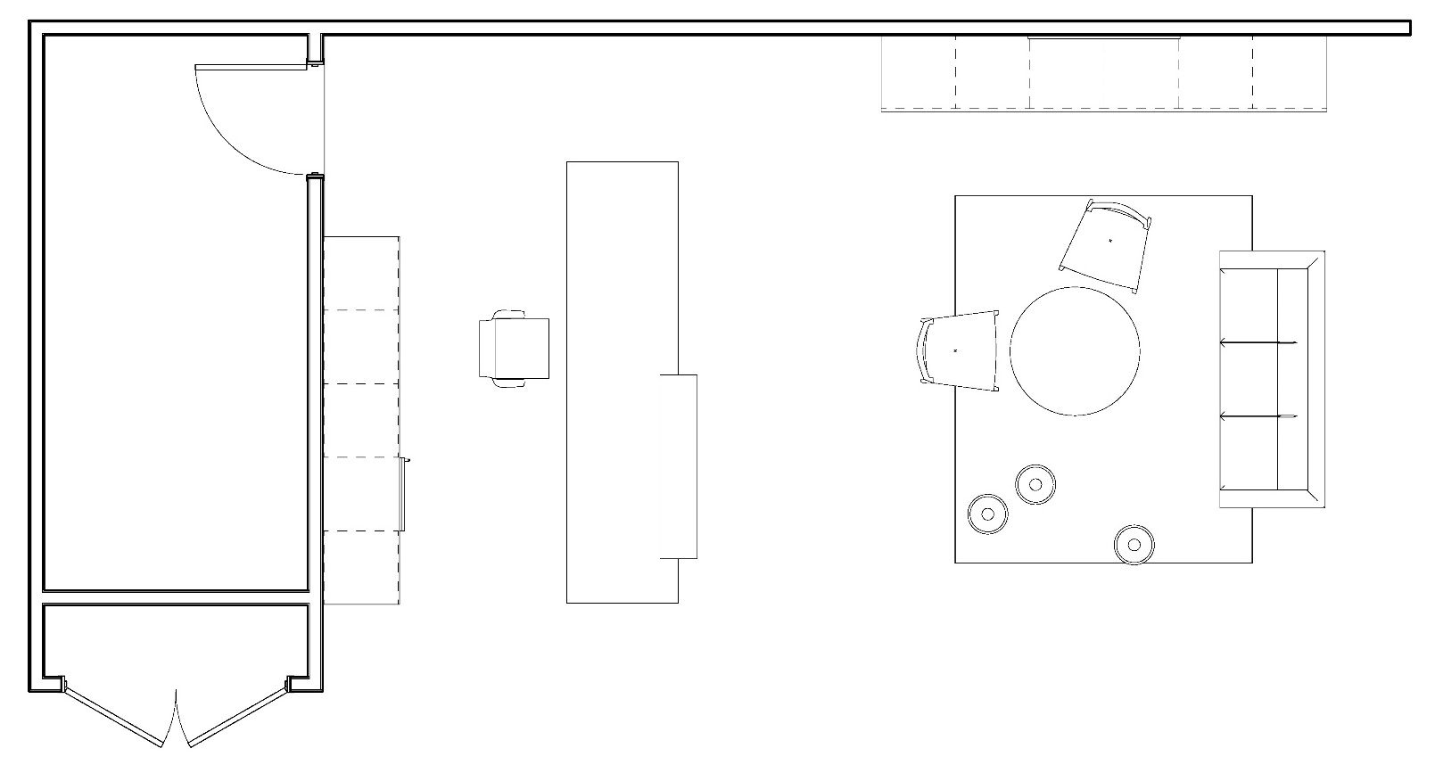
Reception
    Reception Congestion Points:
    Entry / Exit Door
    Reception Desk
    Closet
    Waiting Area
    Sanitation Station
    Nearest Restroom
Consider shield guards at reception
Sanitation Station
6’
Waiting Area
Coat Closet

Slide 27
Shared Spaces

Slide 28
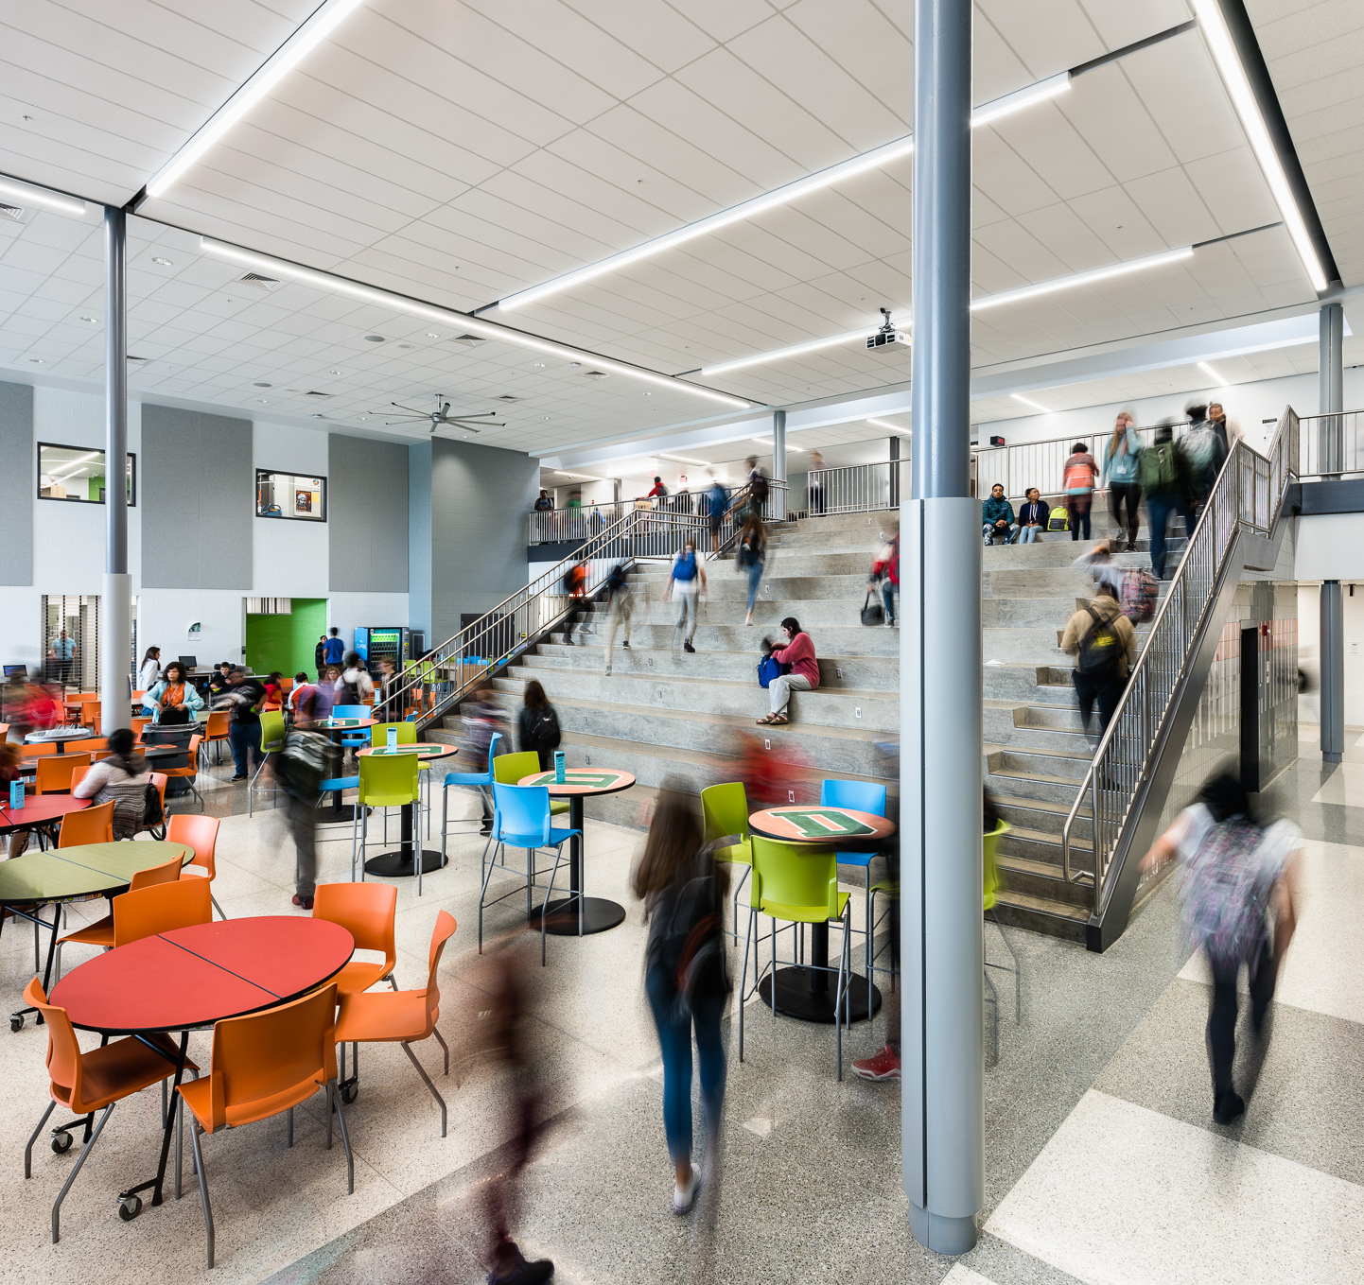
Cafeteria
Consider creating instructional areas in the cafeteria to increase the teaching capacity of the facility
Layout
Provide 6’ distance around all occupiable seats
Mark available and unavailable positions on the tables using tape and/or signage
Add shields at payment and checkout points
Designate sanitizing and handwashing areas
Post signage reminding students of healthy behaviors and handwashing
Operations
Have students eat in their classrooms if possible
Provide single individually wrapped portions
Use only disposable wares

Slide 29
Cafeteria
6 ft. Diameter

Slide 30
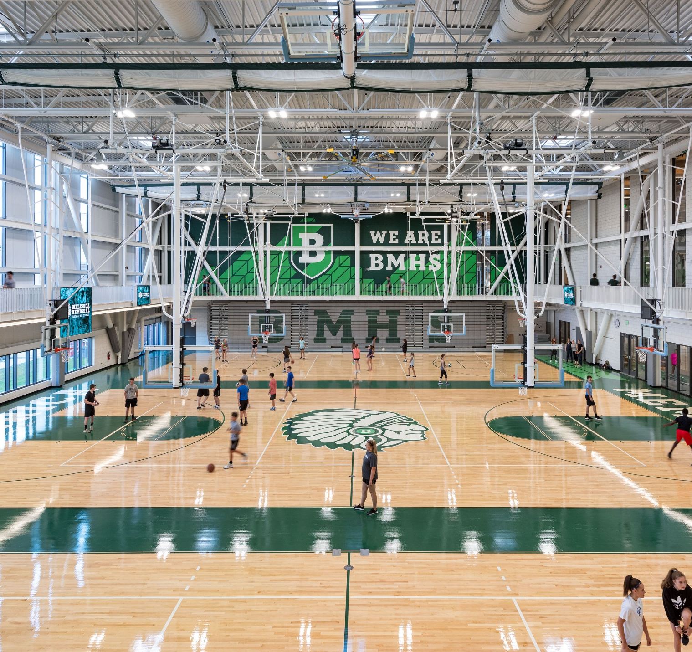
Gym
Whenever possible, hold PE classes outside to allow for maximum physical distance between students
Avoid any activities that would bring students into close physical contact
Due to the level of movement and heavier breathing, increase the distance between students to 10’
Mark visual indicators on the floor and/or walls to illustrate 10’ increments
Consider repurposing the gym for instructional space for teaching/ virtual learning to increase the teaching capacity of the building as large events will not likely be taking place
Disinfect equipment after each use
Avoid activities that would require multiple students to touch or handle the same equipment (e.g. basketball)
Provide sanitizing areas and access to handwashing
Post signage reminding students of healthy behaviors and handwashing
Notes:
Erika Jumps In

Slide 31
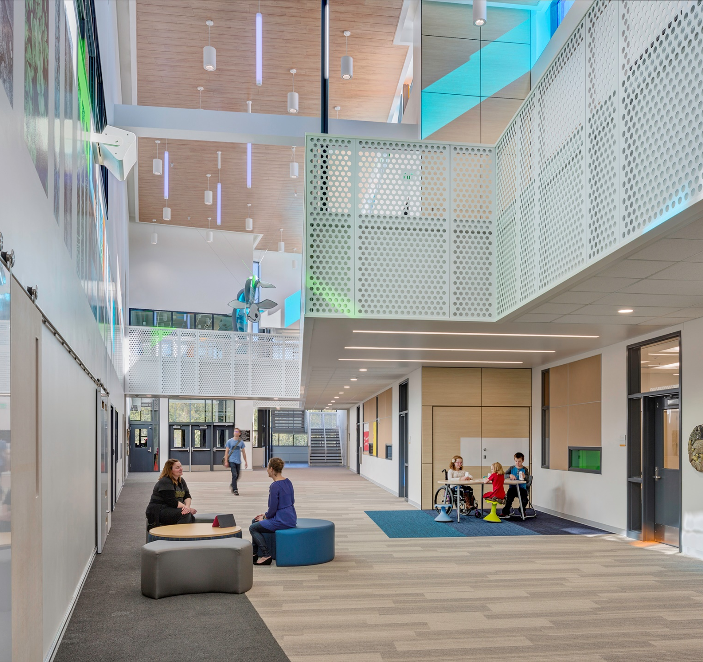
Corridors & Commons
Maintaining distances of 6’ between students in corridors may not be feasible for all schools
Mark 6’ distances on the floor and/or walls to provide visual indicators for students and teachers as they move through the corridor
If possible, discontinue the use of lockers and cubbies until physical distancing recommendations have been lifted
If it is not possible to discontinue the use of lockers, determine which students have lockers 6’ apart and schedule times for locker access based on where student lockers are located
Post signage reminding students of healthy behaviors and handwashing
Provide sanitizing stations throughout
DO NOT institute any corridor usage policies or circulation paths that would disrupt emergency egress routes or prevent students from seeking the nearest exit, or confuse students in the event of an emergency

Slide 32
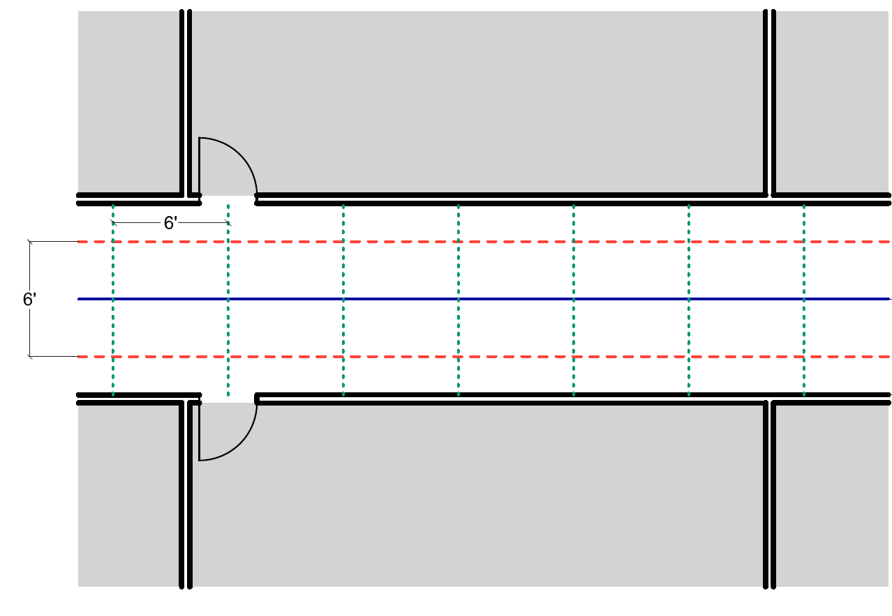
Corridors
Create visual cues to help students maintain physical distances:
Mark a centerline down the middle of the corridor on the floor
Mark paths on the floor 6’ apart on either side of the centerline
Mark 6’ intervals along the floors and/or walls
Width Varies

Slide 33
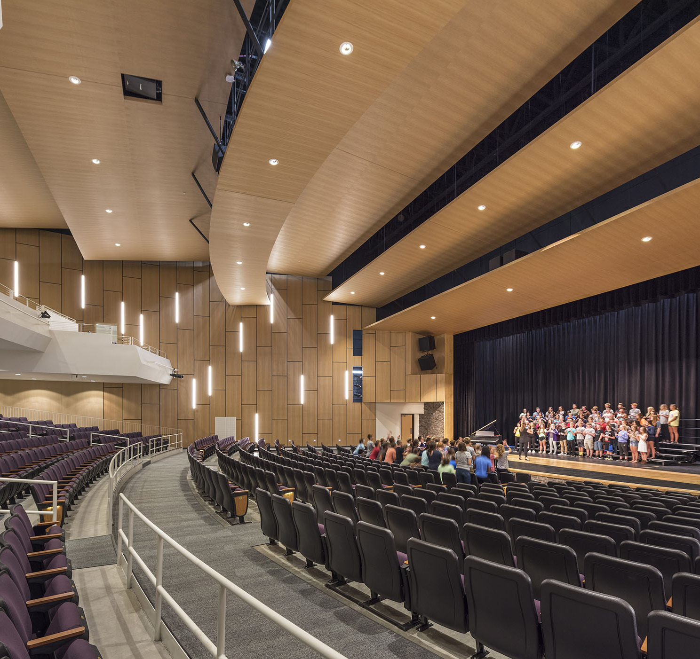
Theater
Blythewood High School
Pre-Covid Capacity = 495
Social Distancing Capacity = 77 (15.5%)
If seating is loose, arrange seats to maintain 6’ separation
If seating is fixed, mark or block off seats as unavailable to maintain 6’ separation
Refer to government guidelines for gathering sizes and numbers of attendees for an event
Consider repurposing areas of the auditorium for instructional space until physical distancing guidelines are lifted, as large events will not likely be taking place
Provide sanitizing stations throughout
Post signage reminding students of healthy behaviors and handwashing
6 ft. Diameter

Slide 34
Buses

Slide 35
School Bus Capacity
Pre-pandemic Seating
71 students
Maintain 6’ separation between students
Carefully consider loading and unloading sequence (first student on sits in furthest back seat and is the last student to exit the bus)
Consider signage or some other means to mark desired seating locations and to restrict access to unused seats
Typical school buses are nominally 8’ wide, length varies depending on row spacing and capacity
Wearing of masks while on bus should be considered
Disinfect between routes
Consult bus manufacturer for possible ways to shield driver.
Prepare for increased parent drop-off and pick-up, encourage walking and biking
Social Distancing Seating
No overlap in circles
8 students
Typical row spacing 28.5”
Semi -Social Distancing Seating
Overlap in circles
12 students
~8’
6 ft. Diameter
Hand Sanitizer Station
Diagrams based on standard BlueBird 71 capacity bus

Slide 36
Goal 3: Learn from Peers

Slide 37
We are in this together.
EXAMPLE (copy and paste if desired):
Subtitle 1 ― Subtitle 2

Slide 38




Capacity Process
Assess the capacity Providence Campus
Outcome: # of students who can fit with physical distancing guidelines
Analyze the current class schedule to establish demand
Outcome: # of students scheduled to be in class during each period
Compare the capacity and demand to establish the shortfall
Outcome: # of students who don’t fit in the classroom after accounting for physical distancing
Develop strategies to make up the shortfall
Outcome: Options to reduce demand on the Providence Campus and repurpose additional space for instruction
Notes:
Our focus in this discussion is look at the options for returning to create a more robust action plan for the Transition Phase – however long that is.
Options are organized into (3) categories:
- Work Location - who is working remotely and who is working in the office?
Operations - how will we work when in the office
Behaviors / Messages – what are the key messages during this time and what alternate behaviors are they supporting?
We are in the Response phase now:
100% remote
Alternate protocols in place
Focus on messages related to the crisis and support of remote working
We want to Plan for the Transition (and this is the focus of this discussion):
Phased Increase in Office Population while evaluating the future state
Working in the office with Enhanced Infection Controls
Physical Distancing
Food & Beverage
Limiting Outside
Maintenance
Personal Protection
Messages to convey new ways of working, in-office practices, and supporting employees with guidance & positivity.
When we move out of the Transition phase we can begin to consider our Future Preparations:
How remote working will evolve into our strategy
What measures we need keep and which ones we need to discontinue
And how we will Reinforce lessons from the response and the transition phases to make our workplace even better.

Slide 39
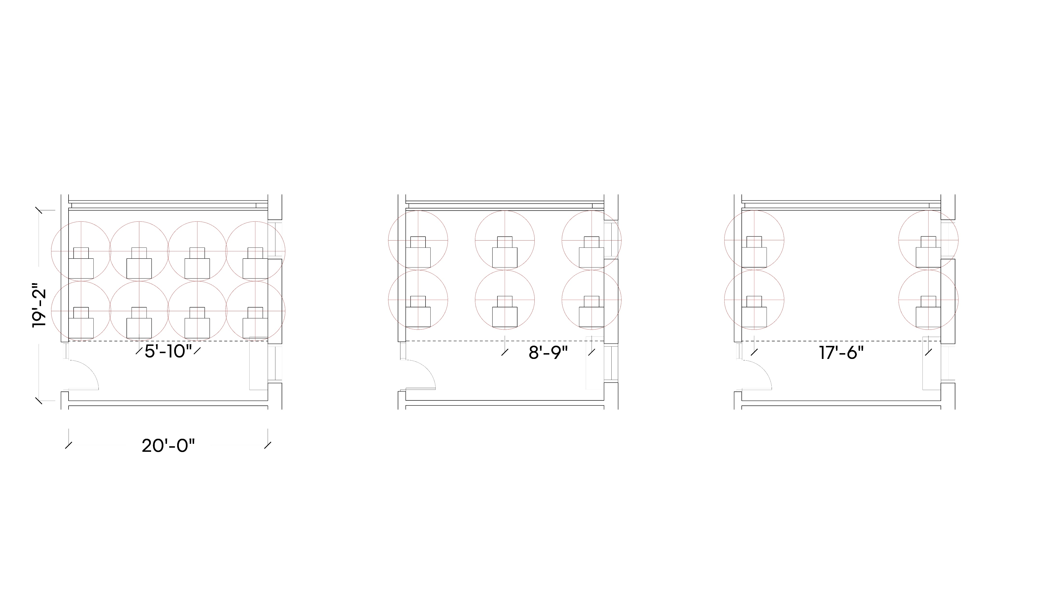
Classroom Capacity Schemes
This study includes three capacity schemes for typical classrooms. Each scheme provides a minimum of 6’ distancing between student desks in the seated position. The Medium and Sparse options also provide a circulation corridor between the 6’ circles.
Typical Wheeler School Classroom (Morgan 106): 388 Sf
Teaching wall assumption
DENSE
MEDIUM
SPARSE
37% reduction vs existing
when applied to entire campus
56% reduction vs existing
when applied to entire campus
68% reduction vs existing
when applied to entire campus
Notes:
Our focus in this discussion is look at the options for returning to create a more robust action plan for the Transition Phase – however long that is.
Options are organized into (3) categories:
- Work Location - who is working remotely and who is working in the office?
Operations - how will we work when in the office
Behaviors / Messages – what are the key messages during this time and what alternate behaviors are they supporting?
We are in the Response phase now:
100% remote
Alternate protocols in place
Focus on messages related to the crisis and support of remote working
We want to Plan for the Transition (and this is the focus of this discussion):
Phased Increase in Office Population while evaluating the future state
Working in the office with Enhanced Infection Controls
Physical Distancing
Food & Beverage
Limiting Outside
Maintenance
Personal Protection
Messages to convey new ways of working, in-office practices, and supporting employees with guidance & positivity.
When we move out of the Transition phase we can begin to consider our Future Preparations:
How remote working will evolve into our strategy
What measures we need keep and which ones we need to discontinue
And how we will Reinforce lessons from the response and the transition phases to make our workplace even better.

Slide 40
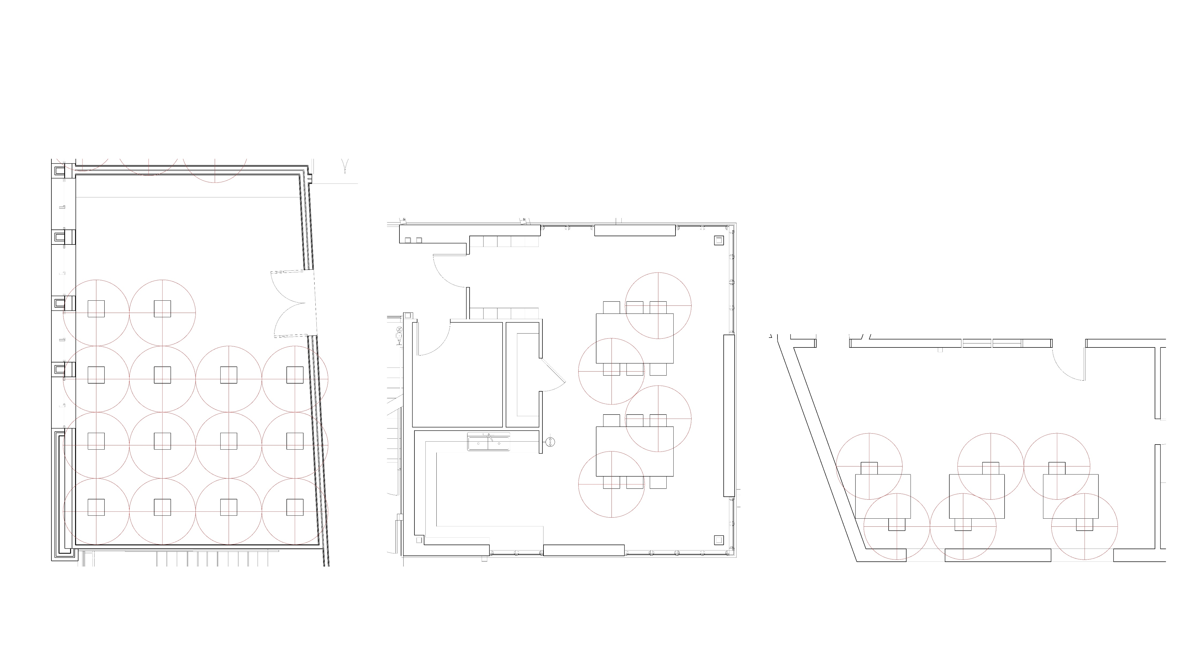
Special Teaching Spaces
Alternative layout options were developed for specialty teaching spaces.
MUSIC
SCIENCE
ART
Notes:
Our focus in this discussion is look at the options for returning to create a more robust action plan for the Transition Phase – however long that is.
Options are organized into (3) categories:
- Work Location - who is working remotely and who is working in the office?
Operations - how will we work when in the office
Behaviors / Messages – what are the key messages during this time and what alternate behaviors are they supporting?
We are in the Response phase now:
100% remote
Alternate protocols in place
Focus on messages related to the crisis and support of remote working
We want to Plan for the Transition (and this is the focus of this discussion):
Phased Increase in Office Population while evaluating the future state
Working in the office with Enhanced Infection Controls
Physical Distancing
Food & Beverage
Limiting Outside
Maintenance
Personal Protection
Messages to convey new ways of working, in-office practices, and supporting employees with guidance & positivity.
When we move out of the Transition phase we can begin to consider our Future Preparations:
How remote working will evolve into our strategy
What measures we need keep and which ones we need to discontinue
And how we will Reinforce lessons from the response and the transition phases to make our workplace even better.

Slide 41
Schedule analysis approach
What if we keep the schedule, but rethink the room assignments?
Plan for the peak demand
The number of students in class at any given time varies throughout the day. Plan for the times when the most students are in class across all divisions.
No change to the schedule
Use the current meeting times and class sizes.
Look holistically at all Divisions
All divisional schedules are combined into a single master schedule to calculate the total demand across all buildings.
Disregard current room assignments
Classes can be scheduled in whichever room is the appropriate size
Notes:
Our focus in this discussion is look at the options for returning to create a more robust action plan for the Transition Phase – however long that is.
Options are organized into (3) categories:
- Work Location - who is working remotely and who is working in the office?
Operations - how will we work when in the office
Behaviors / Messages – what are the key messages during this time and what alternate behaviors are they supporting?
We are in the Response phase now:
100% remote
Alternate protocols in place
Focus on messages related to the crisis and support of remote working
We want to Plan for the Transition (and this is the focus of this discussion):
Phased Increase in Office Population while evaluating the future state
Working in the office with Enhanced Infection Controls
Physical Distancing
Food & Beverage
Limiting Outside
Maintenance
Personal Protection
Messages to convey new ways of working, in-office practices, and supporting employees with guidance & positivity.
When we move out of the Transition phase we can begin to consider our Future Preparations:
How remote working will evolve into our strategy
What measures we need keep and which ones we need to discontinue
And how we will Reinforce lessons from the response and the transition phases to make our workplace even better.

Slide 42
Contact Us
Brooke Trivas
Brooke.Trivas@perkinswill.com

