Slide 1
the Covid-19 vaccine is here: practical recommendations for independent schools
Susan e. Schorr
Laura m. Kahl
December 18, 2020

Slide 2

Today’s agenda
Vaccine Basics
New England vaccine plans and where schools fit in
The pros and cons of vaccine mandates v. recommendations
How to accommodate exemptions to vaccinations
Drafting tips for faculty/staff offer letters and contracts, and enrollment agreements
Where things stand with younger children and vaccination
Reminder: We are lawyers, not doctors!

Slide 3
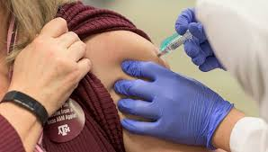
Very quick covid vaccine primer
mRNA (messenger RNA) vaccines (Pfizer BioNTech and Moderna)
    Teach cells how to generate a protein that in turn creates antibodies to fight the virus
    Does not inject any live virus
    Does not affect cell nucleus, where DNA is stored
    Currently no mRNA vaccines licensed in the U.S.
    Research on mRNA for 15+ years
  Other options
    Viral vector (injection of modified, harmless virus to trigger immune response) (Johnson & Johnson and AstraZeneca)
    Protein sub-unit (tend to be weaker, needs a booster shot) (Sanofi)
    Whole virus (live, weakened virus or destroyed virus)

Slide 4
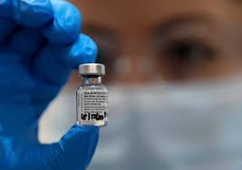
emergency use authorization
FDA mechanism to approve medicines during public health emergency when no other approved and available alternatives
Basic analysis: benefits of therapy outweigh risks and the product meets reasonable thresholds for safety and effectiveness
Analysis is based on the best available evidence, without waiting for all the evidence that would be needed for FDA approval
The public must be given the option to accept or refuse a vaccine and the consequences, if any, of refusing it, the alternatives to vaccine that are available, and of their benefits and risks (informed consent)
Authorization is temporary and only lasts as long as state of pandemic emergency is in effect

Slide 5
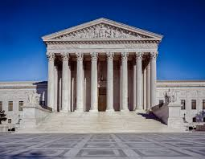
what does the u.s. supreme court say?
Jacobson v. Massachusetts, 1905 case
Man from Cambridge, MA fined $5.00 for refusing to be vaccinated against small pox
States permitted to enact public health laws and mandate vaccines
“...persons and property are subjected to all kinds of restraints and burdens in order to secure the general comfort, health, and prosperity of the state”
“Upon the principle of self-defense, of paramount necessity, a community has the right to protect itself against an epidemic of disease which threatens the safety of its members.”

Slide 6

Where do New England SCHOOLS fit into state vaccination plans?
States had to submit draft vaccine plans to CDC by October 16, 2020
Prioritization framework developed by the National Academy of Science, Engineering, and Medicine
No distinction between public and private school employees
Maine, Massachusetts, NH, RI, Vermont: Teachers and Staff in K-12 schools slated for Phase 2
    In Massachusetts, Phase 2 = February – March 2021
Young adults and children, Phase 3 (note: vaccines not yet approved for children under age 16 and not yet tested on pregnant women)

Slide 7

New Guidance from the EEOC (12/16/20)
A vaccine is not a “medical examination” so OK for employer to administer, but be careful about pre-screening questions
Employers may ask for proof of vaccination from a pharmacy or healthcare provider
Cannot exclude an unvaccinated employee from workplace under “direct threat” analysis unless no way to provide a reasonable accommodation absent an undue hardship
Careful about termination if no accommodation possible due to disability or religious conviction

Slide 8

rationales for mandates
No federal or state laws prohibit an employer from mandating that employees receive vaccinations
COVID-19 has been determined to be a “direct threat” by the CDC based on:
        the duration of the risk;
        the nature and severity of the potential harm;
        the likelihood that potential harm will occur; and
        the imminence of the potential harm
    Anyone who is not vaccinated could be excluded from work based on a “direct threat” analysis under EEOC/ADA guidance
  OSHA requires a safe and healthy work environment
  A requirement could increase employee comfort level by creating a safer workplace environment

Slide 9

rationales for recommendation
Encourage vaccination for the greater good of the school and larger community
Employee resistance/fear—a mandate could backfire and reduce morale
Questions around mandating a vaccine that is subject to emergency use authorization, but not full FDA approval
Potential adverse effects of vaccine could lead to workers’ comp claims or litigation
Ease of administration
Align approach with school culture

Slide 10

New England vaccine exemptions
All states permit medical exemptions
Massachusetts, RI, NH, VT permit religious exemption but not philosophical exemption
Maine no longer allows religious or philosophical exemptions

Slide 11
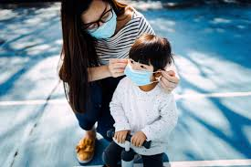
engage in the disability or Religious exemption analysis
Under the Americans with Disabilities Act and Title VII of the Civil Rights Act, need to determine whether an employee who qualifies for a vaccine exemption can still work at the school
Interactive process—must have a dialogue
Possible accommodations
    Working from home/remote teaching
    Mandate wearing a mask at all times
    Temporary transfer to other position
    Use PTO to search for a new job

Slide 12

Faculty/Staff
Offer Letters and contracts
Reference Code of Conduct and need to comply (with added COVID policies and protocols)
Include contingencies:
    Student enrollment
    Remote learning
    Adjusted teaching schedule and academic year
    Modified vacations
    Pro-rate salary

Slide 13

if you want to recommend
Include language in at-will offer letter or employee handbook such as, “In order to promote health in our school community, the school strongly recommends that you are vaccinated against COVID-19.”
Establishes expectations and school culture around prioritizing a healthy community
Provides a level of comfort for your colleagues
Supports concept that vaccination is voluntary

Slide 14
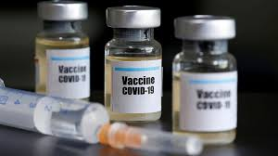
if you want to mandate
Include language in an employee contract such as, “In order to promote health in our school community, employees must be immunized against COVID-19 unless a medical or religious exemption applies. In the event you that you request an exemption, the school will discuss whether reasonable accommodations that do not impose an undue hardship on the school may be made.”
Reinforce in the employee handbook

Slide 15

enrollment contracts
Remote learning
Recording remote learning sessions
Tuition adjustments for room and board?
Force Majeure/School Closure
    Be sure to specifically reference “pandemic”
  Immunizations and COVID protocols
    Will states add COVID-19 vaccine to list of required immunizations?
    Massachusetts added influenza vaccine requirement for this school year

Slide 16

enrollment contracts: school immunization policy
In accordance with [state] law, all students must be immunized unless a medical or religious exemption applies. In the event that a case of a vaccine-preventable disease occurs at the school and your child has not obtained the required immunization, your child will be excluded from school for at least one incubation period after the onset of the last case or as prescribed by the state’s department of public health.

Slide 17

enrollment contracts: covid-19 testing and protocols
During the COVID-19 pandemic, parents understand that the school may require that you monitor the student and your household for coronavirus symptoms and that the student undergo periodic testing, which may be administered by [the school nurse OR a qualified third party vendor]. On behalf of parents and the student, parents consent to comply with the school’s COVID-19 monitoring and testing protocols and understand that in the event that the student tests positive, those results will be provided to the [state’s department of public health], as required by law, but will otherwise remain confidential.

Slide 18

covid vaccines and younger children
Vaccine study results for children ages 12-17 anticipated for early 2021; potential for vaccine by start of 2021 school year
Trial design expected to be finalized in early 2021 for children under 12
Slower trial process
    need to recruit volunteers and obtain parental informed consent
    need to start with lower doses and smaller groups of children
    need to pause and watch for side effects
  States may postpone vaccine requirements for children until 2022-2023...

Slide 19
THANK YOU! this presentation is for informational purposes only and is not legal advice
Susan E. Schorr
susan.schorr@mclane.com
(857) 305-1960
Laura M. Kahl
laura.kahl@mclane.com
(781) 904-2677

